Slide 1
ENG 346 Data Structures and Algorithms for Artificial Intelligence Data Visualizations
Dr. Mehmet PEKMEZCİ
mpekmezci@gtu.edu.tr

Slide 2
Visualization Libraries
Matplotlib
Seaborn
Plotly
Ggplot
…

Slide 3
Types of Features
Numerical: Values with numeric types (int, float, etc.).
Examples: age, salary, height.
Categorical Features: Features that can take one of a limited number of values.
Examples: gender (male, female), color (red, blue, green).
Ordinal Features: Categorical features that have a clear ordering.
Examples: T-shirt size (S, M, L, XL).
Binary Features: A special case of categorical features with only two categories.
Examples: is_smoker (yes, no), has_subscription (true, false).
Text Features: Features that contain textual data.

Slide 4
Types of Plots
Line Charts: Display trends.
Scatter Plots: Investigate relationships between two variables.
Bar Charts: Summarize categorical data and compare different categories.
Pie Charts: Illustrate proportions of a whole for categorical variables.
Histograms: Explore the distribution of individual variables.
Box Plots : Show the distribution and skewness of data, identify outliers.
Heatmaps: Visualize correlation matrices to understand relationships between variables.
Violin Plots: Similar to box plots but also display the probability density of the data.
Density Plots: Visualize the distribution of a single variable.

Slide 5
imports
import numpy as np
import pandas as pd
import matplotlib.pyplot as plt
import seaborn as sns
%matplotlib inline # for Notebooks

Slide 6
# 1st cycle of 1st unit
u1c1_df = df_X_s.loc[(df_A.unit == 1) & (df_A.cycle == 1)].reindex()

Slide 7
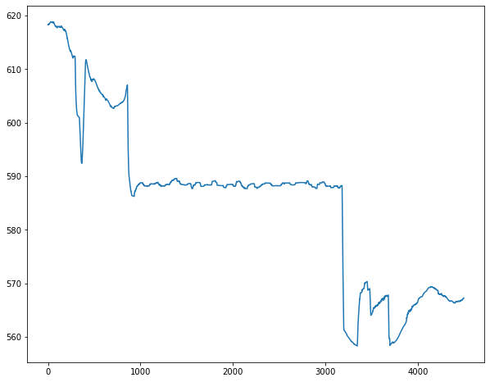
Line Plots
plt.plot(x, y, …)
Example: plt.plot(u1c1_df.T24)

Slide 8
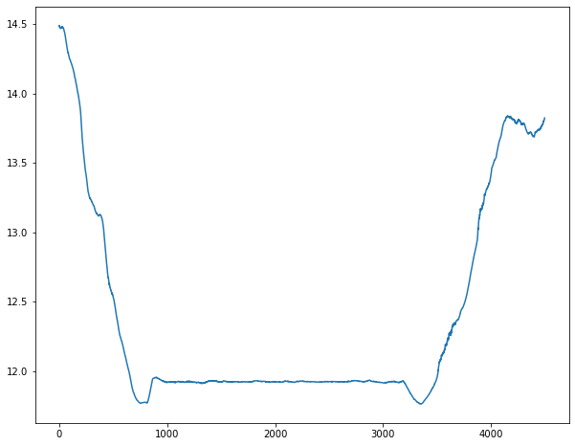
Line Plots – continued
plt.plot(u1c1_df.P2)

Slide 9
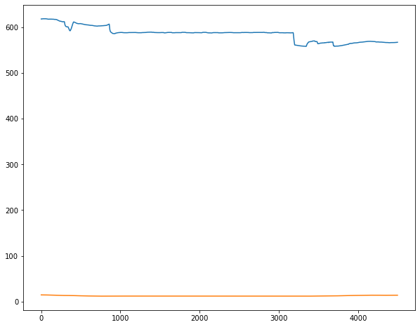
Line Plots – continued
plt.plot(u1c1_df.T24)
plt.plot(u1c1_df.P2)

Slide 10
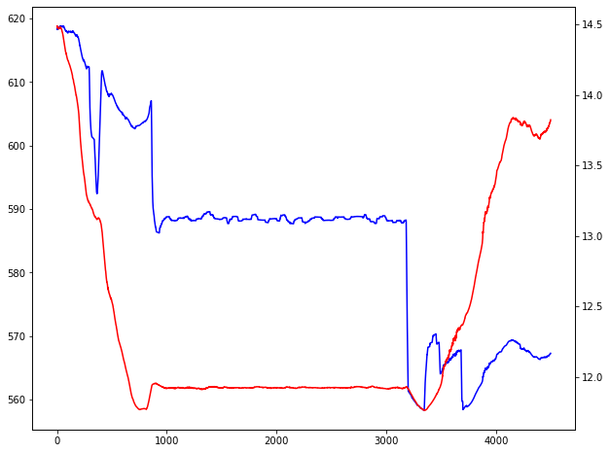
Line Plots – continued
fig, ax1 = plt.subplots()
ax2 = ax1.twinx() # instantiate a second axes that shares the same x-axis
ax1.plot(u1c1_df.T24, color='blue')
ax2.plot(u1c1_df.P2, color='red')

Slide 11
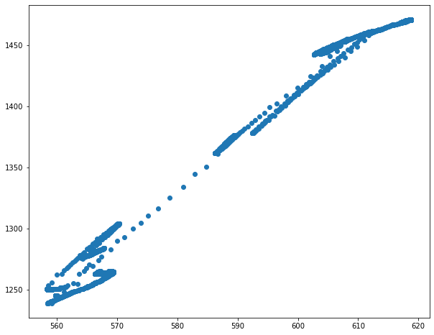
Scatter Plots
plt.scatter(x, y, …)
Example:
plt.scatter(u1c1_df.T24, u1c1_df.T30)

Slide 12
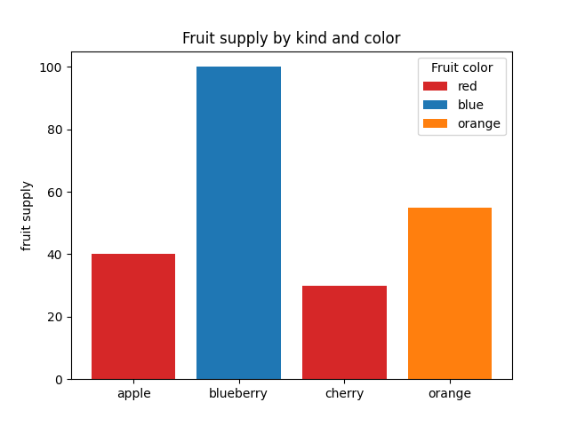
Bar Charts
plt.bar()
Example:
fig, ax = plt.subplots()
fruits = ['apple', 'blueberry', 'cherry', 'orange']
counts = [40, 100, 30, 55]
bar_labels = ['red', 'blue', '_red', 'orange']
bar_colors = ['tab:red', 'tab:blue', 'tab:red', 'tab:orange']
ax.bar(fruits, counts, label=bar_labels, color=bar_colors)
ax.set_ylabel('fruit supply')
ax.set_title('Fruit supply by kind and color')
ax.legend(title='Fruit color')

Slide 13
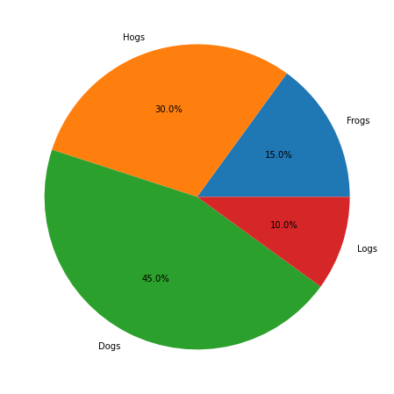
Pie Charts
plt.pie()
Example:
labels = 'Frogs', 'Hogs', 'Dogs', 'Logs'
sizes = [15, 30, 45, 10]
fig, ax = plt.subplots(figsize=(10,8))
ax.pie(sizes, labels=labels, autopct='%1.1f%%')

Slide 14
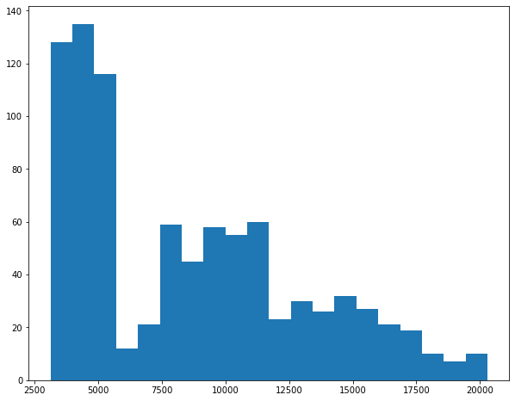
Histogram
plt.hist()
Example:
plt.hist(ux_cycles, bins=20)

Slide 15
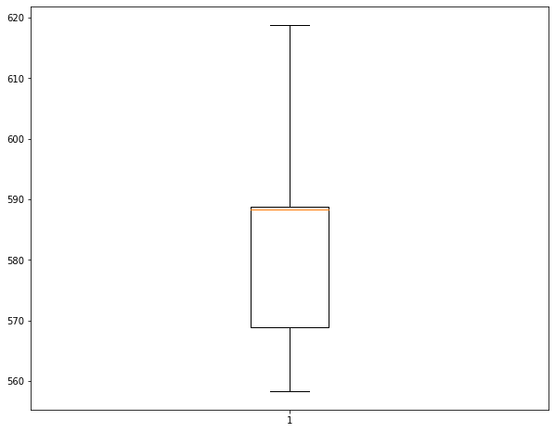
Box Plots
plt.boxplot()
Example:
plt.boxplot(u1c1_df.T24)

Slide 16
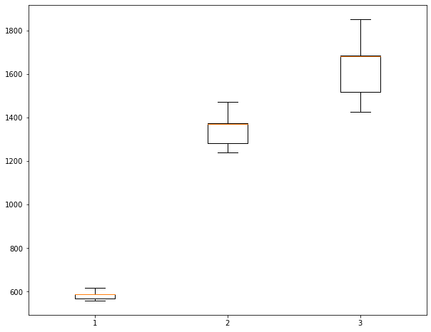
Box Plots – continued
plt.boxplot(u1c1_df[["T24", "T30", "T48"]])

Slide 17
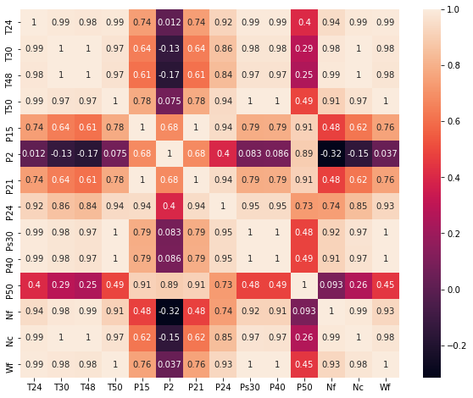
Heatmaps
sns.heatmap()
sns.heatmap(u1c1_df.corr(), annot=True)

Slide 18
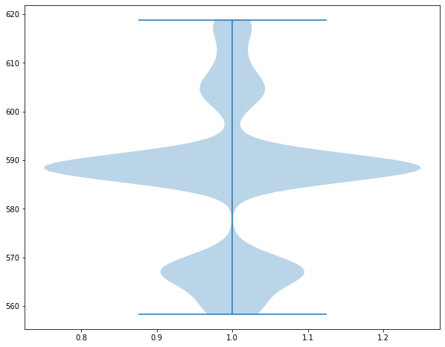
Violin Plots
plt.violinplot()
Example:
plt.violinplot(u1c1_df.T24)

Slide 19
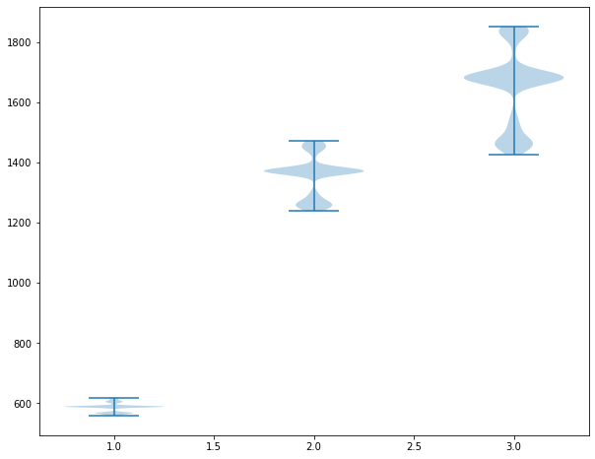
Violin Plots – continued
plt.violinplot(u1c1_df[["T24", "T30", "T48"]])

Slide 20
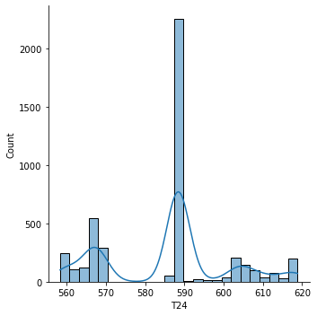
Density Plots
sns.distplot()
Example:
sns.displot(u1c1_df.T24, kde=True)

